Slide 1

School Prospectus
2025-2026

Slide 2
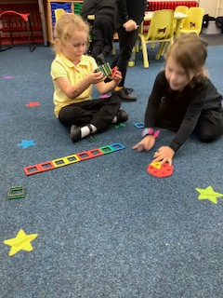
Our vision principles:
Our vision for everyone at Colcot Primary School is;
to inspire ambition, creativity, integrity and compassion - nurturing a desire for lifelong learning.
to be proud of who we are and where we come from by celebrating our rights, heritage and culture.
to equip our children with the skills, knowledge and experiences to succeed in an ever-changing world through a local and global dynamic and exciting curriculum.
to awaken inquisitive minds and develop a sense of wonder and curiosity about the world around them.
to strive to be respectful and empathetic - supporting each other in creating friendships and happy communities.

Slide 3
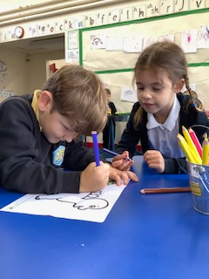
Our mission statement
We are a Rights Respecting School, which is at the heart of our community. We strive to support each learner to achieve their full potential. We provide a safe, happy, nurturing and inspiring environment where all learners can thrive and flourish to become the best that they can be.
At Colcot Primary School we will;
• encourage self-belief and ignite interest and a passion for learning
• promote success through nurturing skills and strengths and creating the environment where children can succeed.
• build relationships by taking the time to get to know learners and their families well, so that we can better understand their needs and how we may best support them.
• treat all learners and their families with respect, kindness and empathy, instilling these values in their day-to-day lives. We will support learners to demonstrate these attitudes in their relationships with others.
• encourage our children to make positive contributions and to take advantage of the opportunities that are available to them.
• celebrate diversity and include all in our proud, caring and happy school.

Slide 4
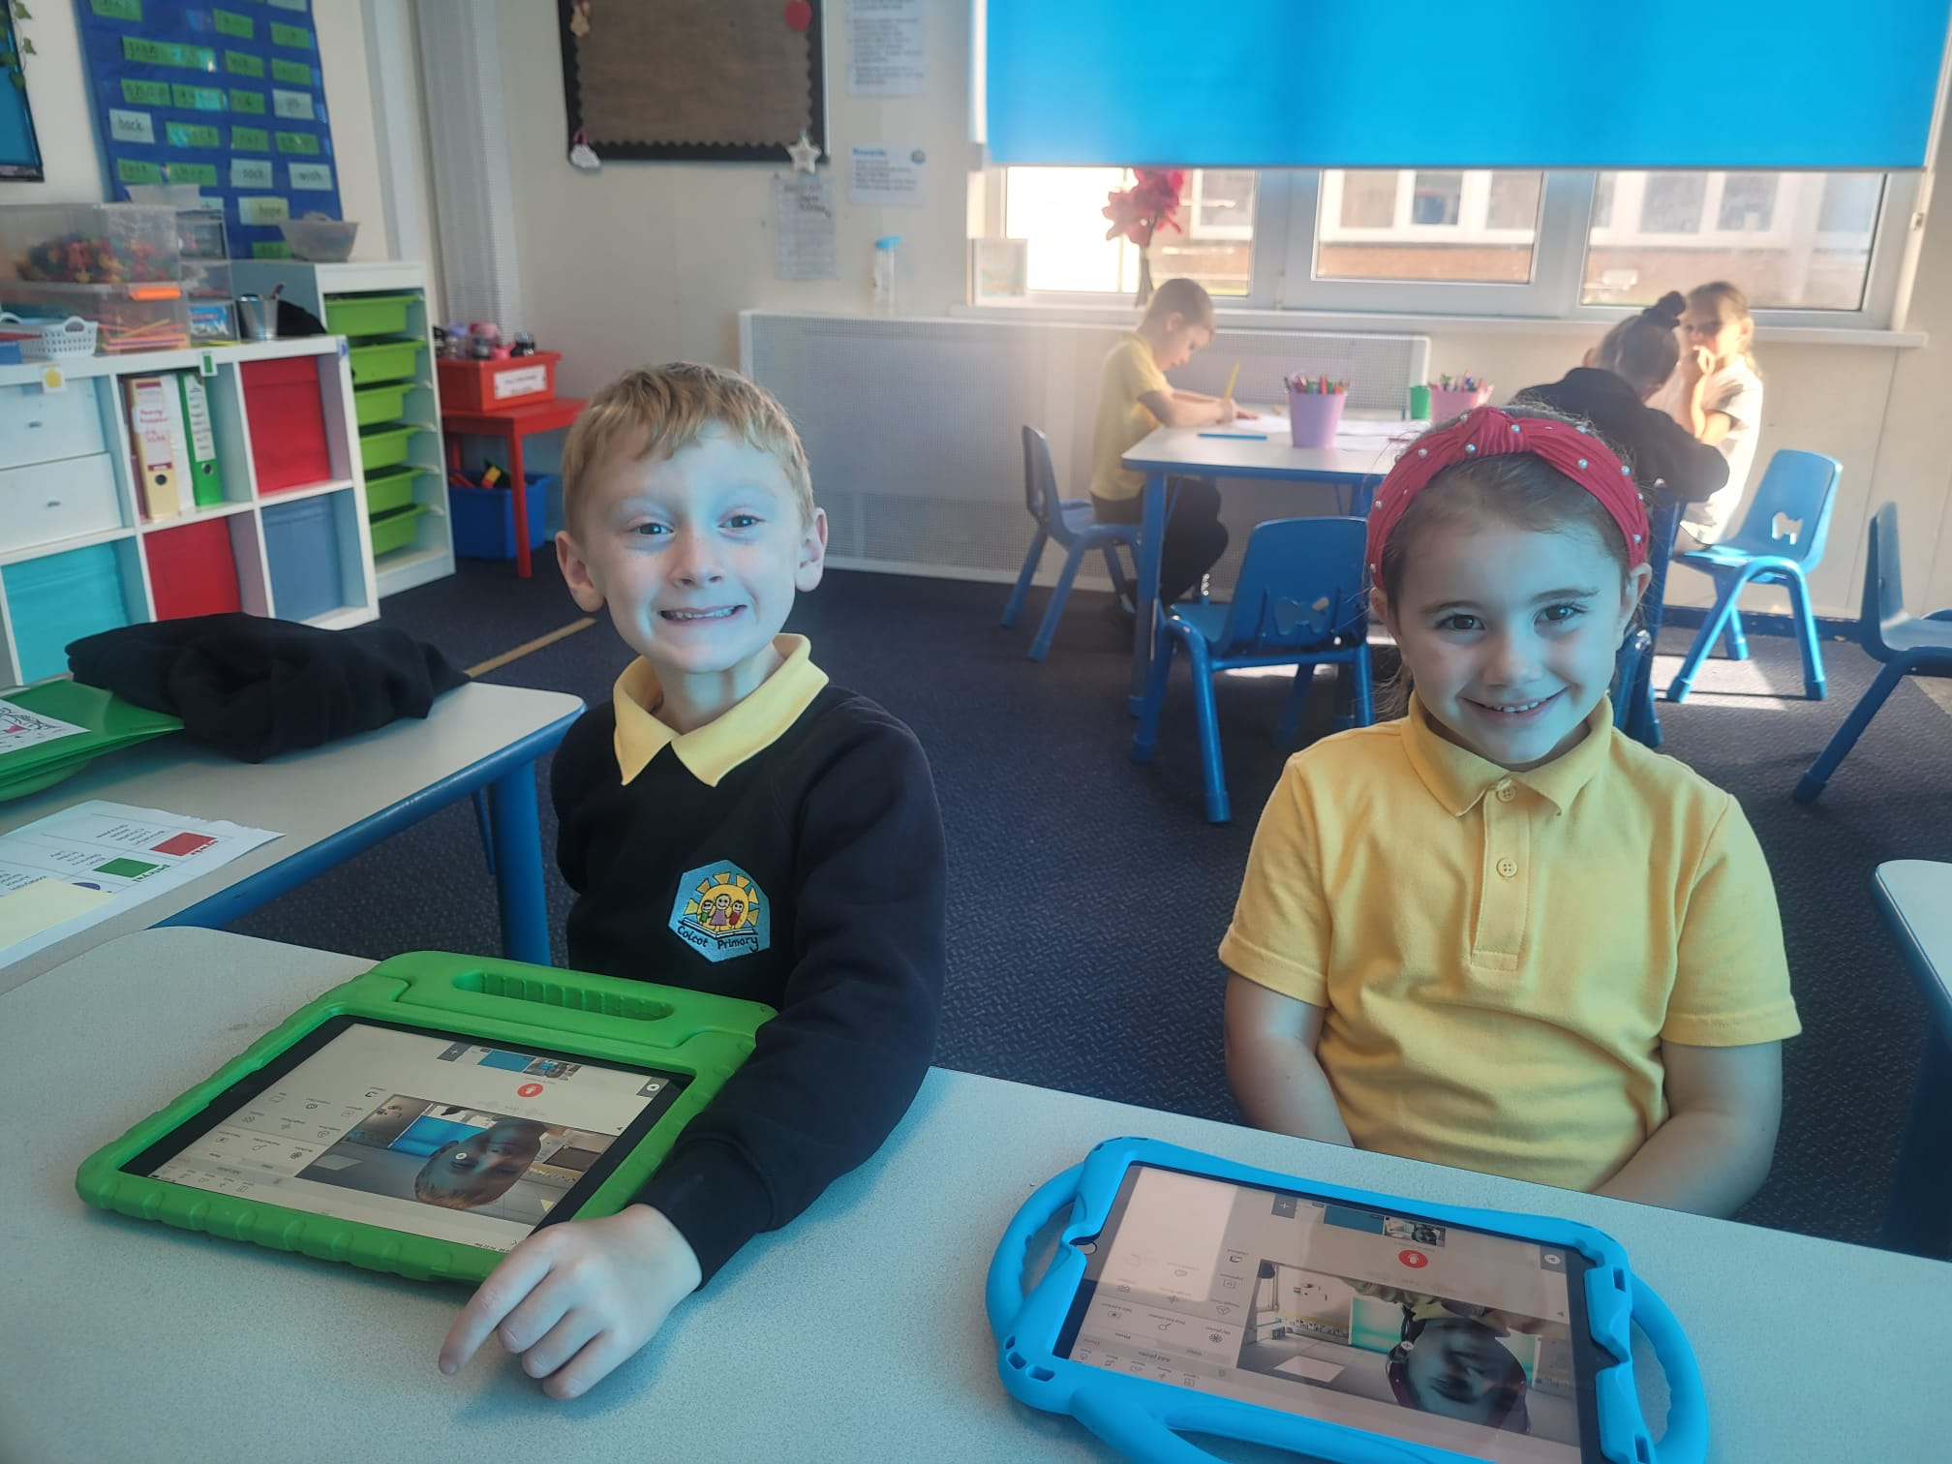
At our school, we are dedicated to nurturing the whole child — equipping every learner with the knowledge, skills, and character they need to thrive in an ever-changing world. Our curriculum is built around the 6C’s of lifelong learning — critical thinking, creativity, collaboration, communication, citizenship, and character — ensuring that children develop the essential competencies to succeed not just academically, but in life. Alongside this, we place great emphasis on cultivating the 24 character strengths, such as curiosity, perseverance, kindness, and leadership, which help our pupils grow into resilient, compassionate, and confident individuals. By weaving these vital skills and strengths into daily learning, we empower our students to become thoughtful, capable, and caring members of society.
Autumn 1 – Character- Self-control, Perseverance, Forgiveness, Humour
Autumn 2 – Critical Thinking – Judgement & Perspective
Spring 1– Collaboration – Fairness, Leadership, Social Intelligence, Zest & Vitality
Spring 2 – Communication – Honesty, Kindness, Gratitude, Humility & Modesty
Summer 1 – Creativity – Curiosity, Kindness
Summer 2 – Citizenship – Teamwork, Hope & Optimism, Love of Learning, Teamwork

Slide 5
Intduction
School Motto
Care, share, learn
Gofal, rhannu, dysgu
Dear Parent
I should like to take this opportunity to welcome new parents and children to the school as well as addressing our existing families. The most important elements of a successful learning environment are the happiness, contentment and security of the children. This can only be achieved by the school, the family and the local community working together in harmony. Our aim is for all pupils to reach their potential, and together we will help them reach their goals.
I hope this prospectus, which may not answer all your queries immediately, will, nevertheless, provide a comprehensive and informative guide to most of the philosophy, organisation and management of the school. We pride ourselves on the broad, balanced and full education we provide our children form Progression Step 1 -3.
We are proud to say that visitors to our school comment on the warm welcome they receive, the positive ethos at the school and the polite and courteous pupils. Our priority is to ensure that all pupils are able to achieve and be the best they can. Pupils achieve more when they are happy and want to learn. We make every effort to ensure that all pupils are given the opportunity to share their learning with their peers and their families and learn from each other.
Should you have any questions about the school or think that we can further help your child in any way, please do not hesitate to contact myself, a member of staff or one of the school’s governors.
Yours sincerely,
N E Cule

Slide 6
Chair of Governors Welcome

Slide 7
Governors understand their roles and support the school effectively – ESTYN 2018

Slide 8
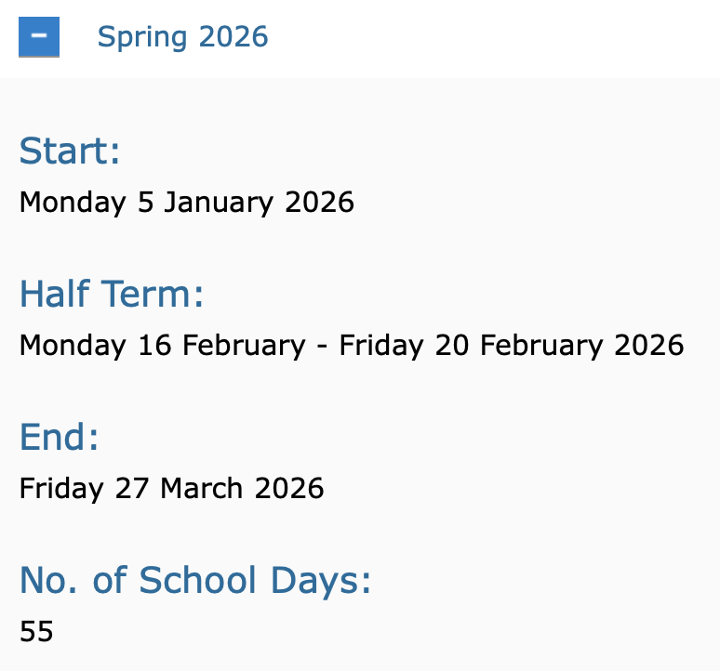
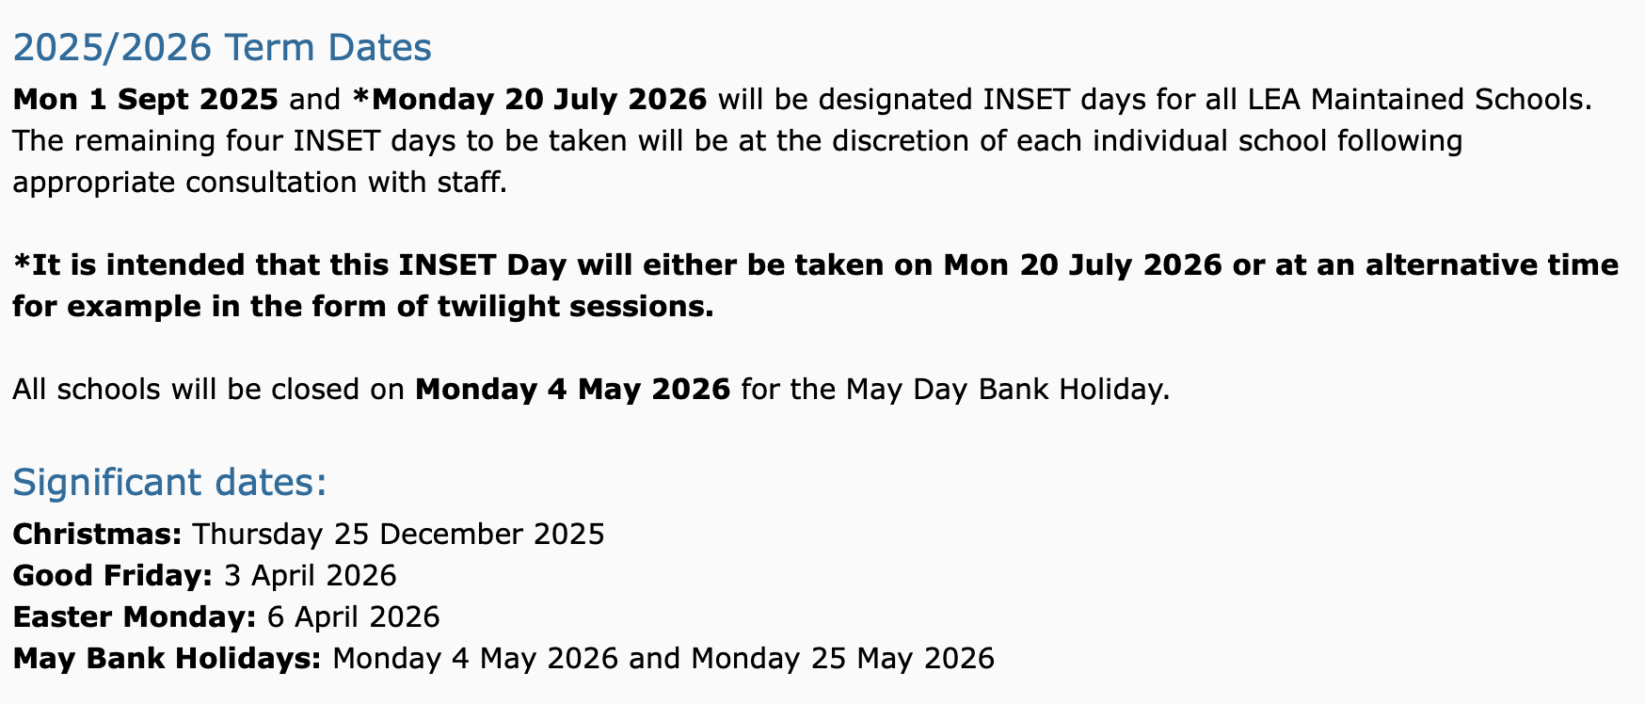
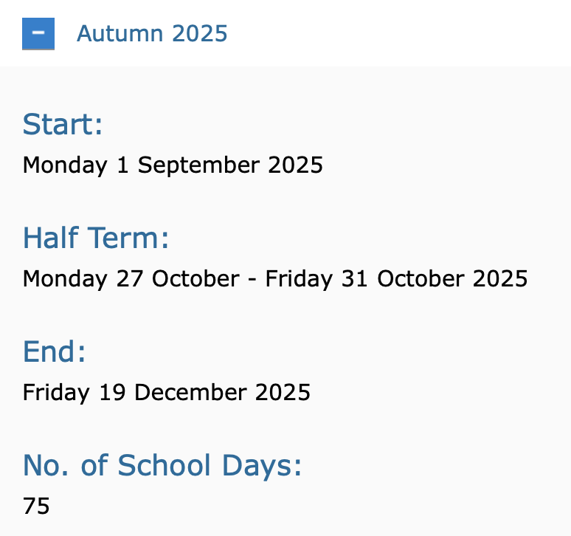
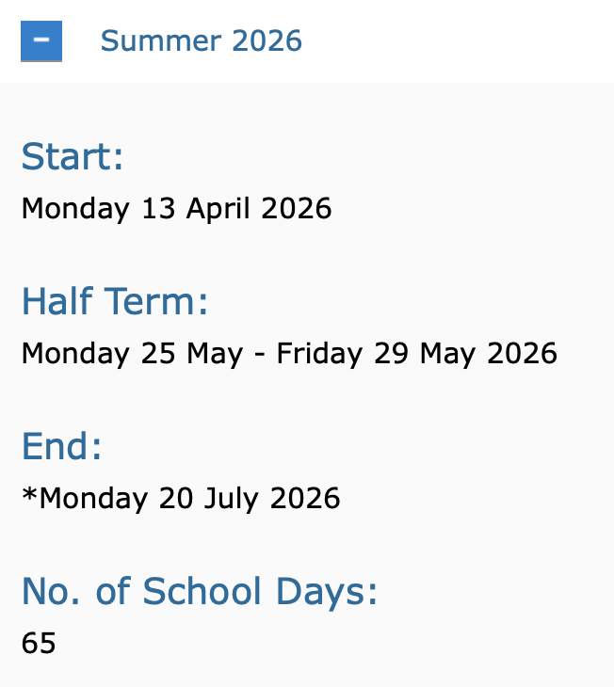

Slide 9
Classroom Staff
HT - Nia Cule
DHT – Shaun O’Connell
AHT – Claire Bosomworth
ALNCo - Jodie Rose
Progression Step 1and 2 Leader - Louise Sanderson
Progression Step 3 Lead – Zoe Thomas
PPA Cover – Josh Rush (HLTA)
Greig Halliday (HLTA)
Karen Parsons (Teacher)
Teachers | Learning Support Assistants
V.Noble M.James R.Humpage R.Ellis M.Hibbert D.Clash O.Greenow M.Hopkins | T.Everitt C.Jenkins L.Holmes S.Morgan D.Lane J.Bennett K.Marvel H.Stokes C.Binns G.Williams Megan Fowler

Slide 10
Support Staff
Mrs J.Abbott Business Manager
Miss A.Davies School Admin Support P/T
Mrs N.Gooderham School Cook
Miss S.Thomas. Head Cleaner
BREAKFAST CLUB STAFF
Mrs N.Gooderham, Mrs T.Everitt, Mr S.Rice, Mrs H.Maguire, Mrs S.Riggott, Miss L.Holmes, Miss N.Davies, Miss J.Griffiths
MIDDAY SUERVISOR STAFF
Mr S.Rice, Mrs H.Maguire, Mrs S.Riggott, Miss N.Davies, Miss J.Griffiths, Mrs C.Romain, Miss C.Holmes

Slide 11
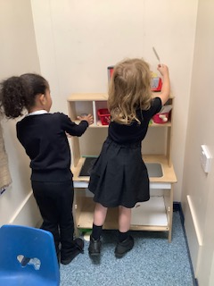
Our School day
Breakfast Club 8 a.m start
School gates are open from 8.45 a.m
Registers are taken from 8.55 a.m. - 9.05 a.m
Morning Break 10.30 a.m. - 10.45 a.m / 10.50am– 11.05am
Staggered Lunch 12 – 1.30 p.m
End of day - 3.30 p.m.
Morning Nursery 9 a.m - 11.30 a.m.
Afternoon Nursery 1 p.m - 3.30p.m.
Our expectation is that all children are in their classrooms at 8.55 a.m and ready to learn. Children who are late must be brought to the School Office and must be signed in.
Our younger children must be collected from school by an adult. Older siblings and family members can collect if they are 16+ years old and if this has been agreed by the school.
Breakfast Club is available for Rec - Year 6 children – the menu changes every day and includes cereal, yogurt, toast and a drink.
A healthy snack is provided in school and can br brought from home in PS3.

Slide 12
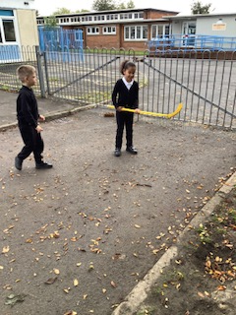
Playtimes and lunchtimes
The children have access to the field and the playground and the staff on duty encourage team games and other activities.
We also have a climbing frame and fitness trail for the older children to access.
When the weather is wet the children will go outside for fresh air and use the playground. If the weather is extremely wet the children will stay in their classrooms and the teachers will stay with them to supervise - colouring and table top games will be provided.
Lunchtime staff supervise the children when they are in the dining hall and outside. Some children have additional staff to support them at lunchtime
Children can choose a school meal or to bring a packed lunch. The older children have the option to choose a baguette, jacket potato or cooked meal. As salad bar is available.
The Leadership Team are on duty every day both in the dining area and outside area.

Slide 13
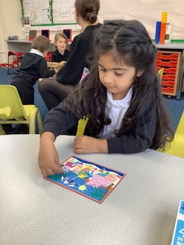

Slide 14
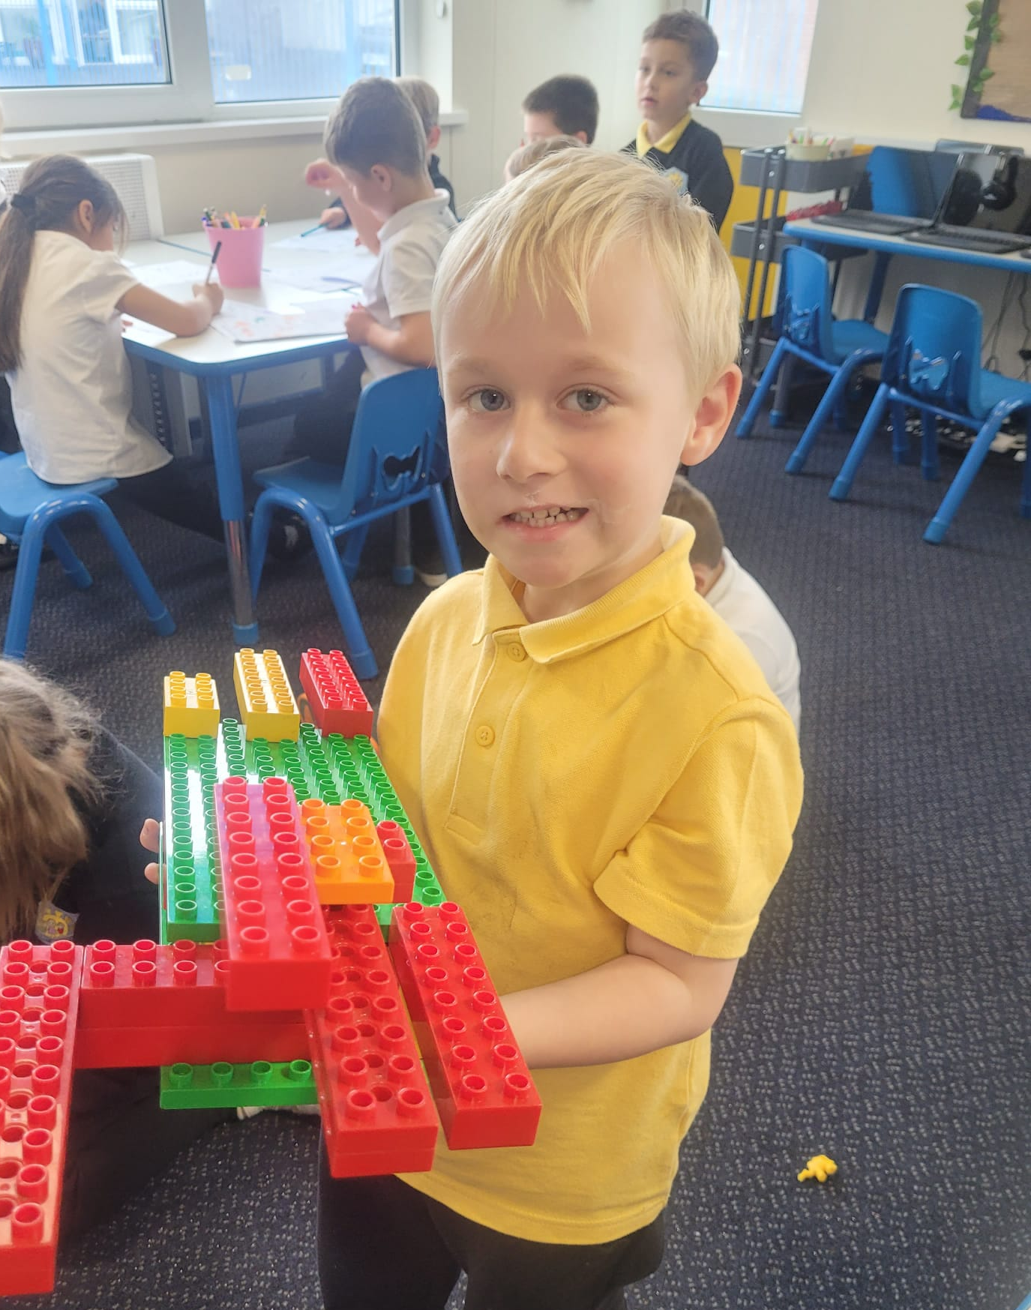
School/Parent Contacts (Complaints Procedure)
When parents have concerns there are a number of direct points of contact which can and should be used in order that issues can be dealt with promptly, transparently and efficiently. Most immediate would be the class teachers. If the issue needs the attention of the Headteacher or senior staff an appointment is necessary in order that a sufficient period of uninterrupted time is devoted to the subject of concern. If the problem is urgent then the school will always seek to respond immediately, other priorities or emergencies permitting.
All official complaints should in the first instance be made in writing to the Headteacher who will clarify the matter and then, if necessary, make the appropriate formal arrangements to investigate the matter and report back.
In the event of an unsuccessful resolution then the matter should be referred, again in writing, to the Chair of Governors. Please note that Governors should not be approached, officially or unofficially, as this would prejudice any investigation and disqualify them from any involvement in the proceedings.
The Vale of Glamorgan LA may review the School’s procedure in dealing with the complaint but will not investigate or make a judgement on the decision itself. Investigation of complaints is entirely the responsibility of the School and the Governing Body.
The school sincerely believes its effective relationships with parents and the local community, and the strenuous efforts it makes to satisfactorily resolve issues transparently, fairly, thoroughly and promptly via informal procedures, will mean that the above official procedures will be rarely called upon.

Slide 15
Vehicle Access
We do not allow any vehicle access during the school day. The gates are locked between 8.30 a.m. and 3.45 p.m.
Any vehicles requiring access must contact the school office before accessing the site.
Administering medication
A member of the Leadership Team will administer medication during the day. Our expectation is that parents complete the appropriate forms and ensure that there is sufficient medication in school. We also expect parents to inform the school of any changes to the medication.
Charging
Parents will be requested to make a contribution towards any school organised function where a fee is charged to the school. If insufficient contributions are forthcoming, indicating that a deficit may arise which will have to be met by the school, then the school reserves the right to cancel the function. With the exception of non-returnable deposits, all paid monies will be returned in full.

Slide 16
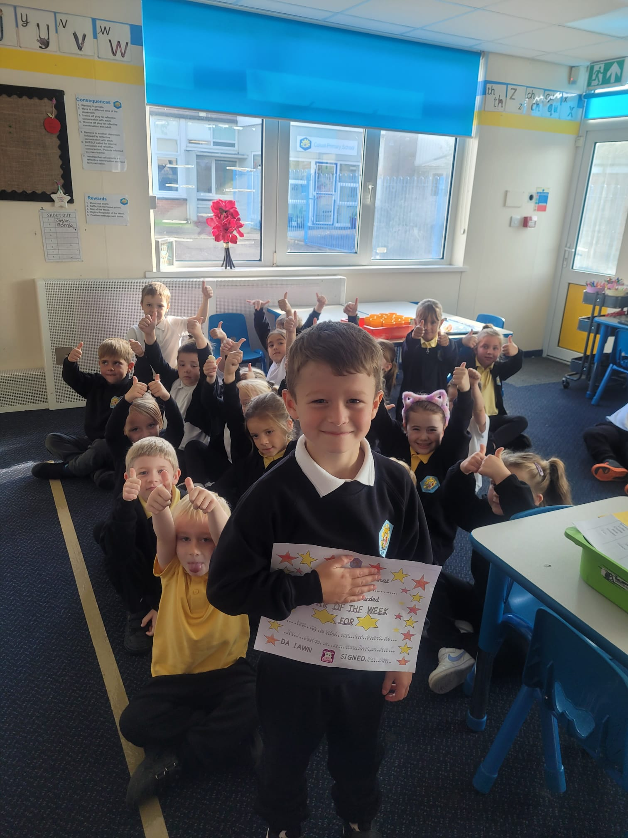
Attendance
Attendance is a key priority for our school. Attendance is monitored weekly and parents are contacted if there are concerns for their child’s attendance. If the school feel it is necessary they will make a referral to the Inclusion Service.
Our school target this year is 92%
Our expectation is –
Parents will contact the school on the morning of an absence and provide a reason for absence
The school admin officer will contact the parents of any child whose absence isn’t explained.
The school will make contact with parents on day 3 of an illness – unless it is an illness expected to exceed 3 days absence
The Attendance Officer will monitor attendance weekly
Parents will be contacted if their child’s absence is below 91%
If there is no improvement after 3 weeks a referral will be made to the Inclusion service.
A reward system will be in place for children above 91% attendance
Family Holidays in term time will not be authorised

Slide 17
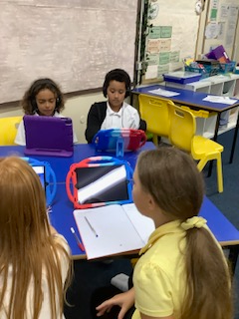
School Uniform
Our expectation is that the children wear school colours. Badged uniform is available from our suppliers Ruckleys and A Class Apart, however this is not a requirement.
Our uniform is
Black joggers, trousers or skirt
White, black or yellow polo shirt
Black sweatshirt
Black shoes or trainers
PE Kit
Black joggers or shorts
White t - shirt
Older children can come to school wearing their P.E Kit. Younger children are encouraged to bring their P.E kit in a bag and leave in school. Changing for P.E is part of the younger children’s learning.
We do not encourage children to wear jewellery to school for health and safety reasons.

Slide 18
Communication
School to families
Families to school
E.Mail
Phone
Letters
Seesaw
Newsletters
Arbor App
E.Mail
Phone
Letters
Arbor App

Slide 19
Designed for All - Colcot Curriculum
A school’s curriculum is everything a learner experiences in pursuit of the four purposes. It is not simply what we teach, but how we teach and crucially, why we teach it. Curriculum development is at the heart of Colcot Primary School and we seek to raise standards for all, tackle the attainment gap, and ensure an education system that is a source of national pride and confidence.
We are now using inquiry based learning focusing on authentic learning that allows our learners to explore, discuss, and meaningfully construct concepts and relationships in contexts that involve real-world problems and projects that are relevant to the learner. We have identified that it is essential for our learners to have opportunities to gain knowledge and skills of the world around them, particularly focusing on 'Cynefin' (understanding our Welsh heritage).
As a school we have identified the importance of outdoor learning in our curriculum. Therefore we have planned for lots of opportunities for our pupils to engage with the curriculum outdoors in various locations around our community. For example we have used Porthkerry and Barry Island to enhance the learning and to allow our learners to apply their skills and knowledge in real life contexts.
An integral part of preparing for the new curriculum is engaging with parents and informing them – or reminding them – about the changes to come.

Slide 20
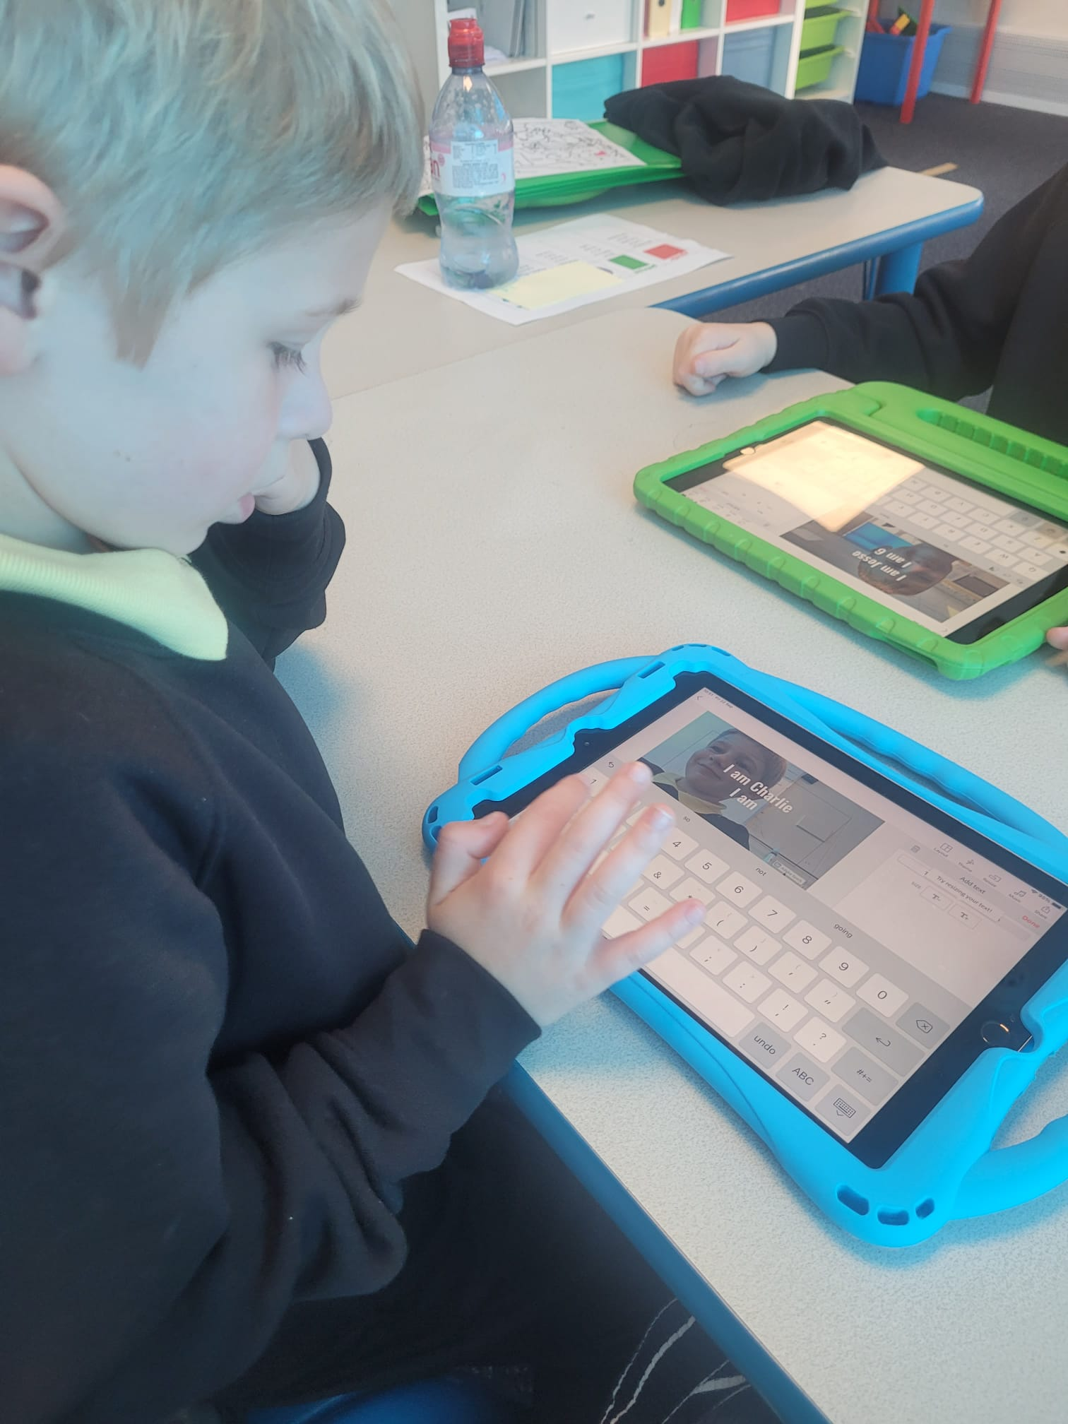
Curriculum for Wales
Progression Step 1 and 2, 3 – 8 Year olds.
At this stage the main learning blocks of learning experiences are laid. The emphasis will be on developing essential skills of communication, literacy and numeracy. By providing a broad rich curriculum using an integrated approach the aim is to develop the children’s interests whilst also recognising their level of maturity. These are important years where pupils learn how to observe, listen, respond and develop not only as individuals but as caring members of the school community.
This model is in place for children in the N, R, Y1, Y2 and Y3. The “Integrated Day” operates with discrete Literacy and Numeracy sessions. This involves the children working through a number of preset tasks at their own pace throughout the day. The overriding factor in planning work in all classes and all subjects is appropriate and accurate differentiation for each ability group. The children’s work will be designed to suit their ability.
The curriculum is designed to ensure the implementation of the Curriculum for Wales and to reference the Areas of Learning.

Slide 21
Progression Step 3, 8 – 11 Year olds.
The essential skills of communication, literacy and numeracy will be the central focus of the curriculum. As the pupils understanding increases more time will be given to the four AOLEs – Humanities, Expressive Arts, Science and Tech, Health and Wellbeing. The curriculum will still take place within an integrated theme where it is meaningful and relevant. The teaching will be led in an Inquiry based format. Children will be encouraged to develop self – confidence, independence in learning and higher order skills in a range of situations.
Curriculum for Wales

Slide 22
RSE and RVE
Relationships and Sexual Education.
As a school we cover this area of learning fortnightly through the main topics, during our Collective Worship time and use the Jigsaw scheme.
Religion, Values and Ethics.
As a school we cover this area of learning fortnightly through the main topics, during our Collective Worship time and using the Discovery scheme.

Slide 23
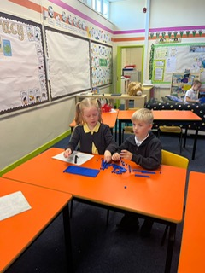
Assessment
As a school we complete the following assessments –
Personalised Assessments in Reasoning and Procedural Mathematics, and Reading
Non Verbal Assesssments
PM Reading
SELFIE
Motional
Single Word Spelling Tests/HFW
LNF Assessments
White Rose Maths Assessments

Slide 24
Additional Learning Needs
As a school we ensure the needs of all children through high quality teaching and learning provision. Our Universal Provision includes:
whole class teaching
effective differentiation
collaborative group work
individual and small group interventions
appropriate and reasonable adjustments to enable access to the school environment, curriculum and facilities

Slide 25
Pupils with disabilities
We are an inclusive school.
As a school we effectively promote equality of access and opportunity for all.
We are robust in our efforts to tackle social disadvantage.

Slide 26
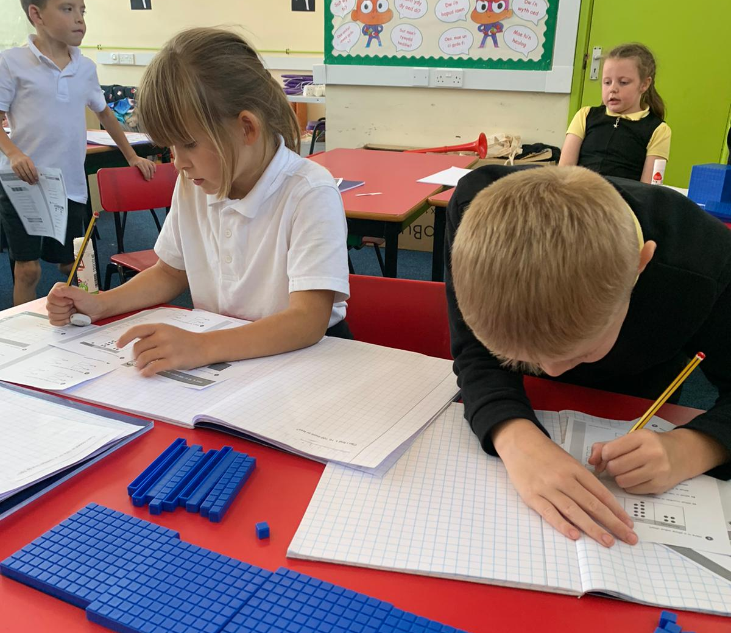
Home learning
As a school regular home learning activities are encouraged.
Our expectations are that reading and spellings are practiced regularly at home.
Tables and basic number concepts should also be practiced regularly.
During the year there will be additional activities linked to the inquiry work that is being covered in the classes which could include art and creative activities.

Slide 27
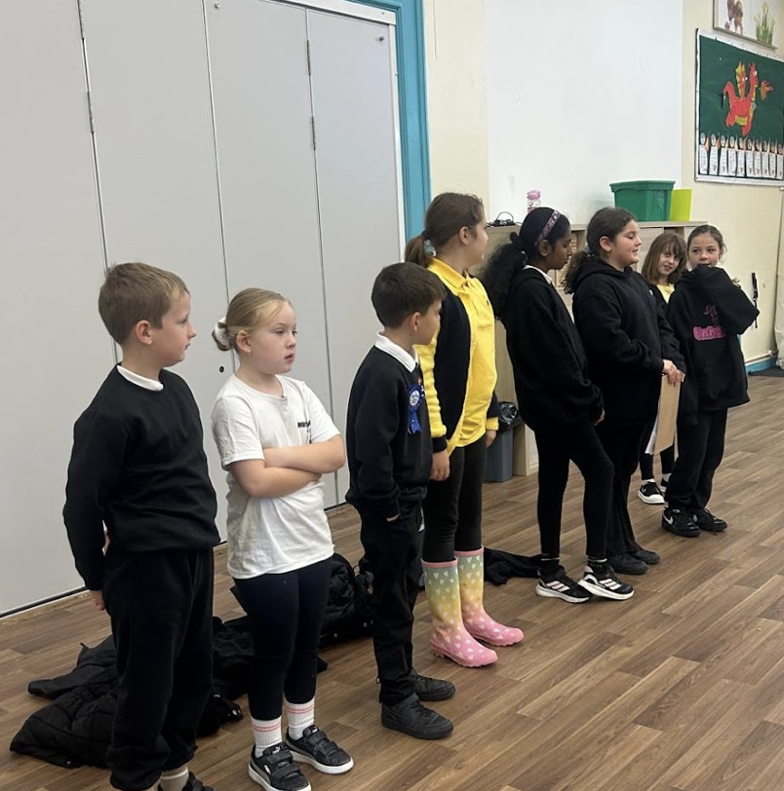
SCHOOL COMMITTEEES
At our school, we believe that every voice matters. Pupils are empowered to share their ideas, shape decisions, and make a real difference through active participation in a range of school committees. These include our Senedd, where children lead on whole-school initiatives; the Eco Committee, championing sustainability and care for our planet; the Digital Ambassadors, promoting safe and innovative use of technology; the Rights Respecting Group, ensuring that every child’s rights are understood and upheld; and Criw Cynefin, celebrating and strengthening our Welsh identity and culture. Together, these groups nurture leadership, responsibility, and a strong sense of community.

Slide 28
Family Conferences
The school arranges 2 family conferences during the year, one in the Autumn and one in the Spring Term.
The children will lead the Spring Term meetings and share their learning with their family. There will also be an opportunity for the children and teachers to share the next steps of learning.
The school will produce and end of year report for parents in the Summer term detailing the child’s achievements in the areas of learning.

Slide 29
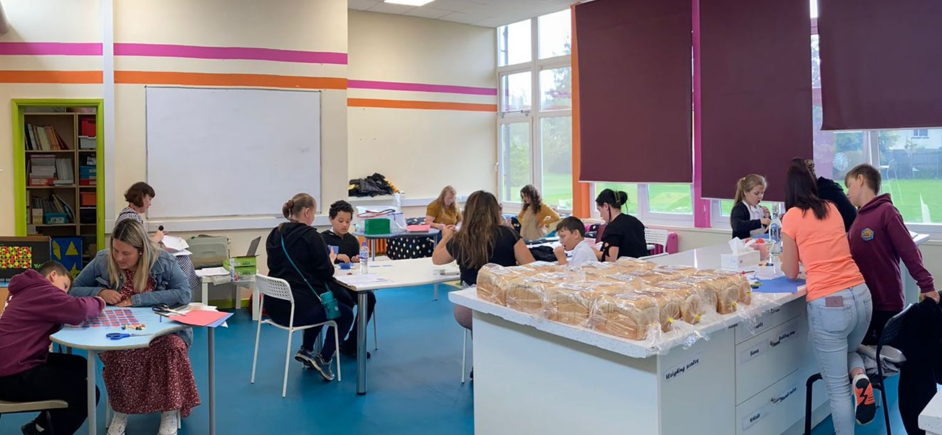
Summary
Our Community
At Colcot we believe in the importance of strong community links. These links can be developed as part of the curriculum and can involve local businesses and local partnerships.
We develop these links in many different ways and our Family Engagement Officer plays a key role in this work through different projects.
We offer weekly adult learning sessions.

Slide 30
Security
All visitors must sign in on entry to our Reception Office.
All visitors must wear a lanyard, different coloured lanyards are given to parents, supply staff and visitors.
Our main gates are on a security lock and visitors can only gain access to the school site when office staff allow them.

